Slide 1

BIO727P
Bioinformatics Software
Development Group Project
Team Liam
Vi Bui, Uppy Gill, Liam Johnson, Neha Khairnar
Tutorial – 24th February 2022

Slide 2
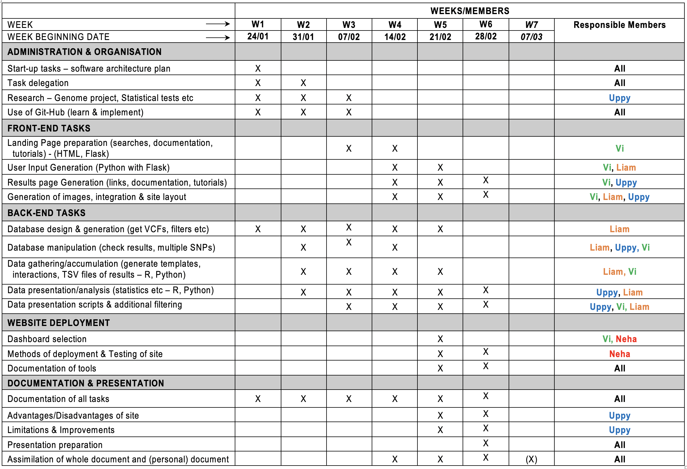
Project Plans
SNPEuro Portal

Slide 3
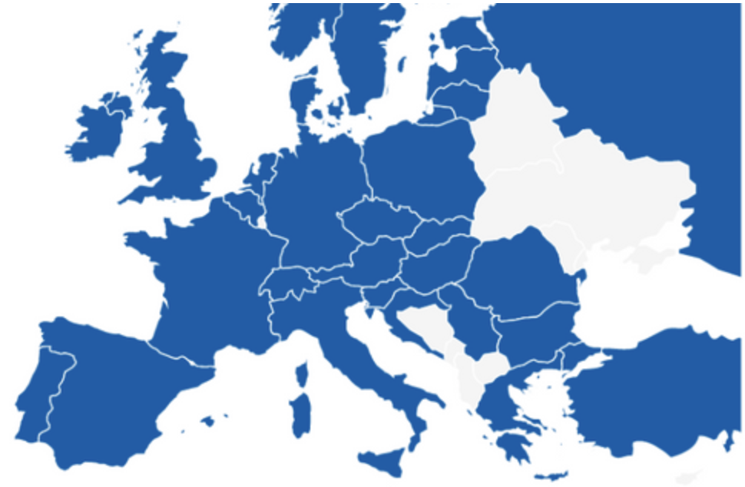
Database Preparation
Chosen populations for SNPEuro Portal:
- British
- CEPH
- Finnish
- Iberian
- Toscani
SNPEuro Portal

Slide 4
Progress Demonstration
Front-End (Flask)
Current issues with statistical test/population selection code
Issue with Rstudio and length of file
SNPEuro Portal

Slide 5
Plans for remainder & next week
Results table to finalise
Fix code with current issues – stats/populations
Results page with summary statistical tests (& images)
Modifications of website for functionality
Documentation – ongoing
Presentation!....
SNPEuro Portal

Slide 6


